Slide 1
What We Know We Don't Know
Hillel Wayne
Notes:
in/hillel-wayne/?

Slide 2



← this one

Slide 3
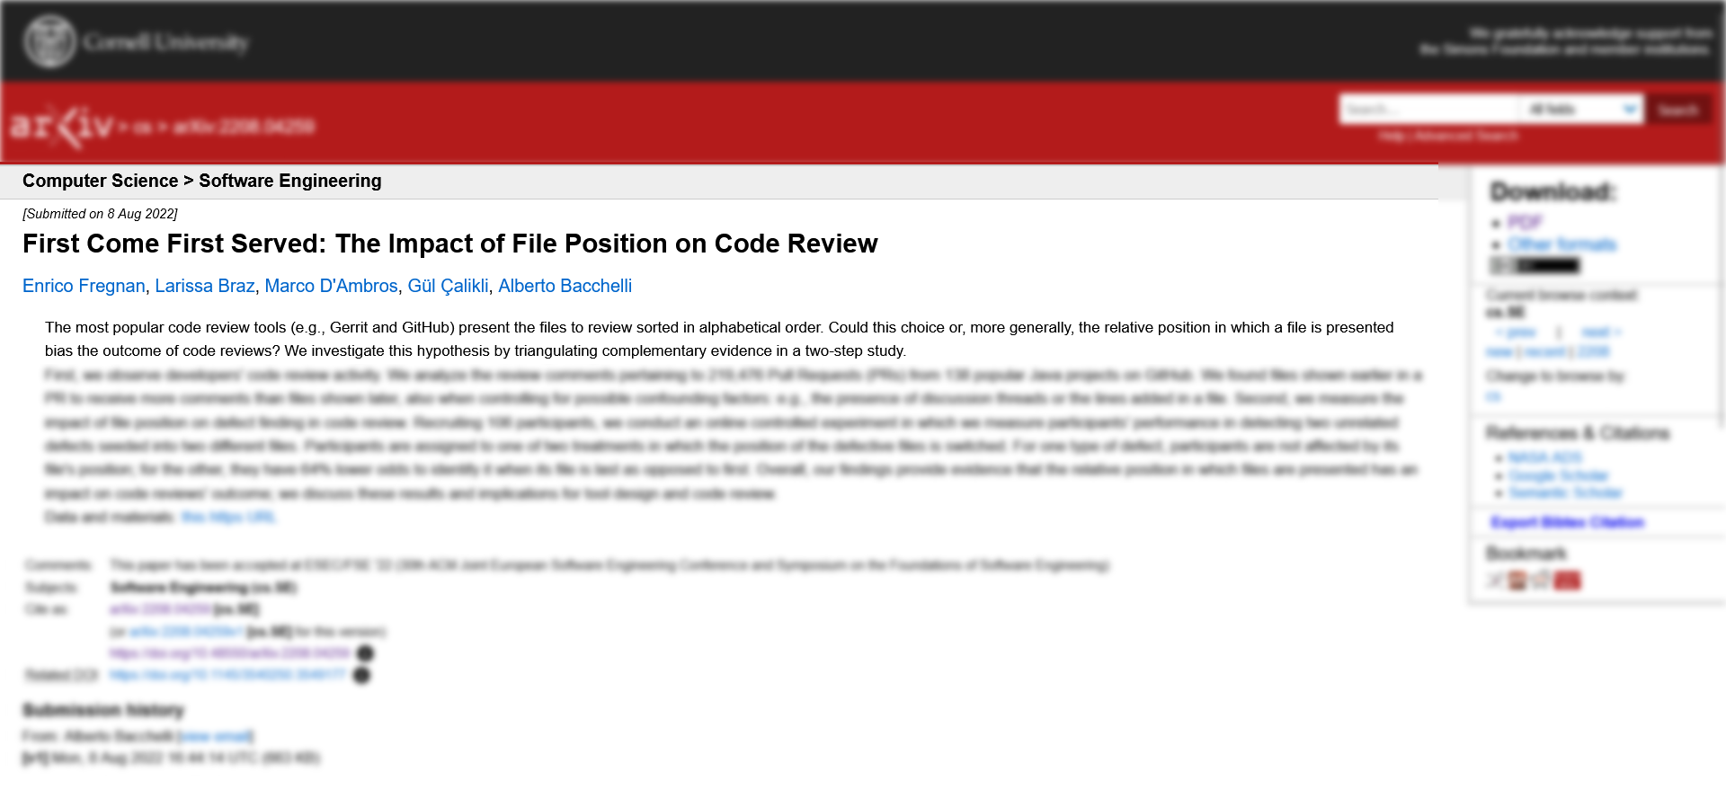

Slide 4
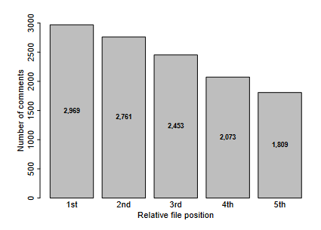
Notes:
40% fewer comments

Slide 5
72.6% of participants [in the study] rejected the idea that files’ position influenced their ability [to find bugs].
- Impact of File Position of Code Review
Notes:
77 of [106]
The hidden psychological factors of code review. At the end of
our experiment, we showed the participants the defects we seeded
in the code. When asked whether the position of the bugs might
have had an impact on their ability to detect them, a vast amount of
the developers replied negatively. A total of 77 (72.6%) participants
rejected the idea that files’ position influenced their ability to find
for the Corner Case defect. However, the results of our experiment
found evidence of the contrary. The impact of file position on reviewers
was also corroborated by the first part

Slide 6

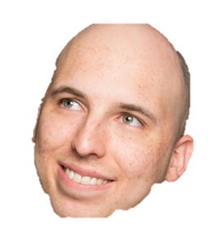
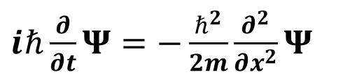
$iℏ\frac{∂}{∂t}Ψ=−\frac{ℏ^{2}}{2m}\frac{∂^{2}}{∂x^{2}}Ψ$
€€€
Notes:
Fascinated by science of software
" " science in general

Slide 7
TDD is a discipline for programmers like ... sterile procedure is for surgeons. Are there times when surgeons don’t use sterile procedure?
- Uncle Bob, The Pragmatics of TDD

Slide 8
Test-first fundamentalism is like abstinence-only sex ed: An unrealistic, ineffective morality campaign for self-loathing and shaming.
- David Heinemeier Hansson, TDD is dead. Long Live Testing.

Slide 9
What We Know We Don't Know:
Empirical Software Engineering
Hillel Wayne

Slide 10
Topics
Why Empirical Engineering Matters
What it looks like
What it says (or doesn’t say)
How to learn more

Slide 11
www.hillelwayne.com/talks/ese/ddd
Notes:
References
Notes
Questions
I try to adapt this talk to my audience's interests

Slide 12
Scientific Method
Observe
Predict
Test
Evaluate
Notes:
Just to recap

Slide 13
Clinical Trial
Notes:
Clinical trials: A/B testing

Slide 14
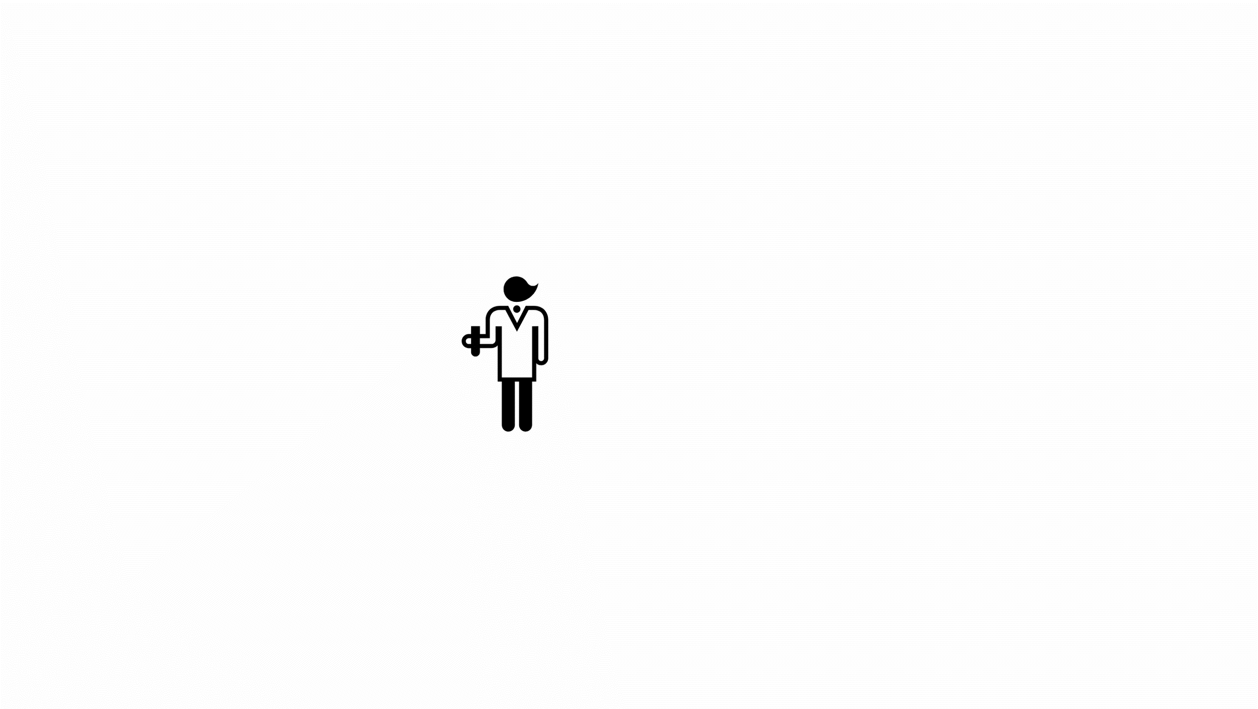
Notes:
And yes, this is basically an A/B test

Slide 15
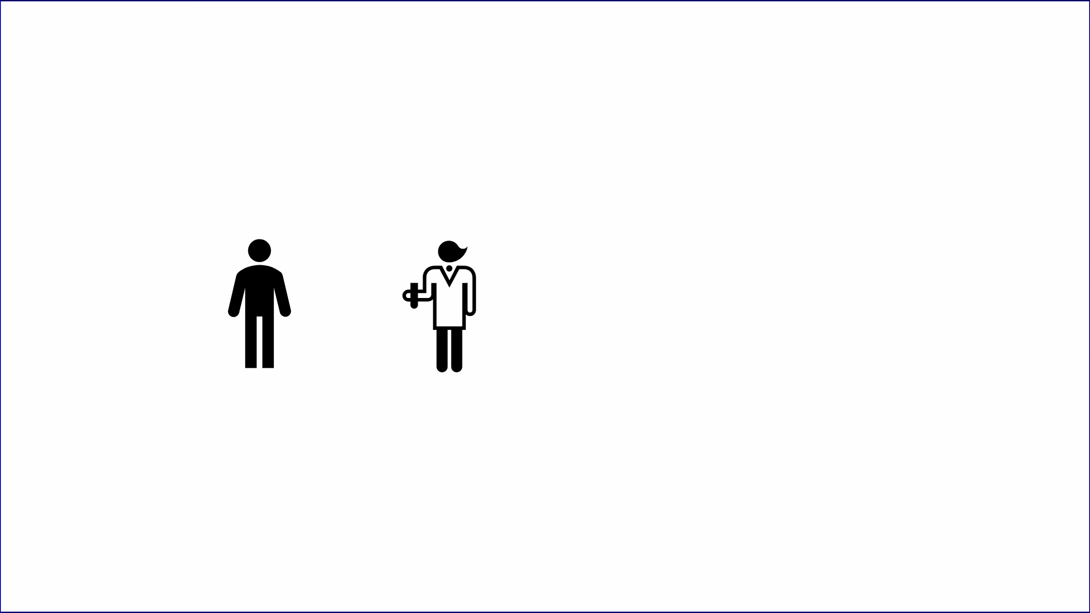
Notes:
And yes, this is basically an A/B test

Slide 16
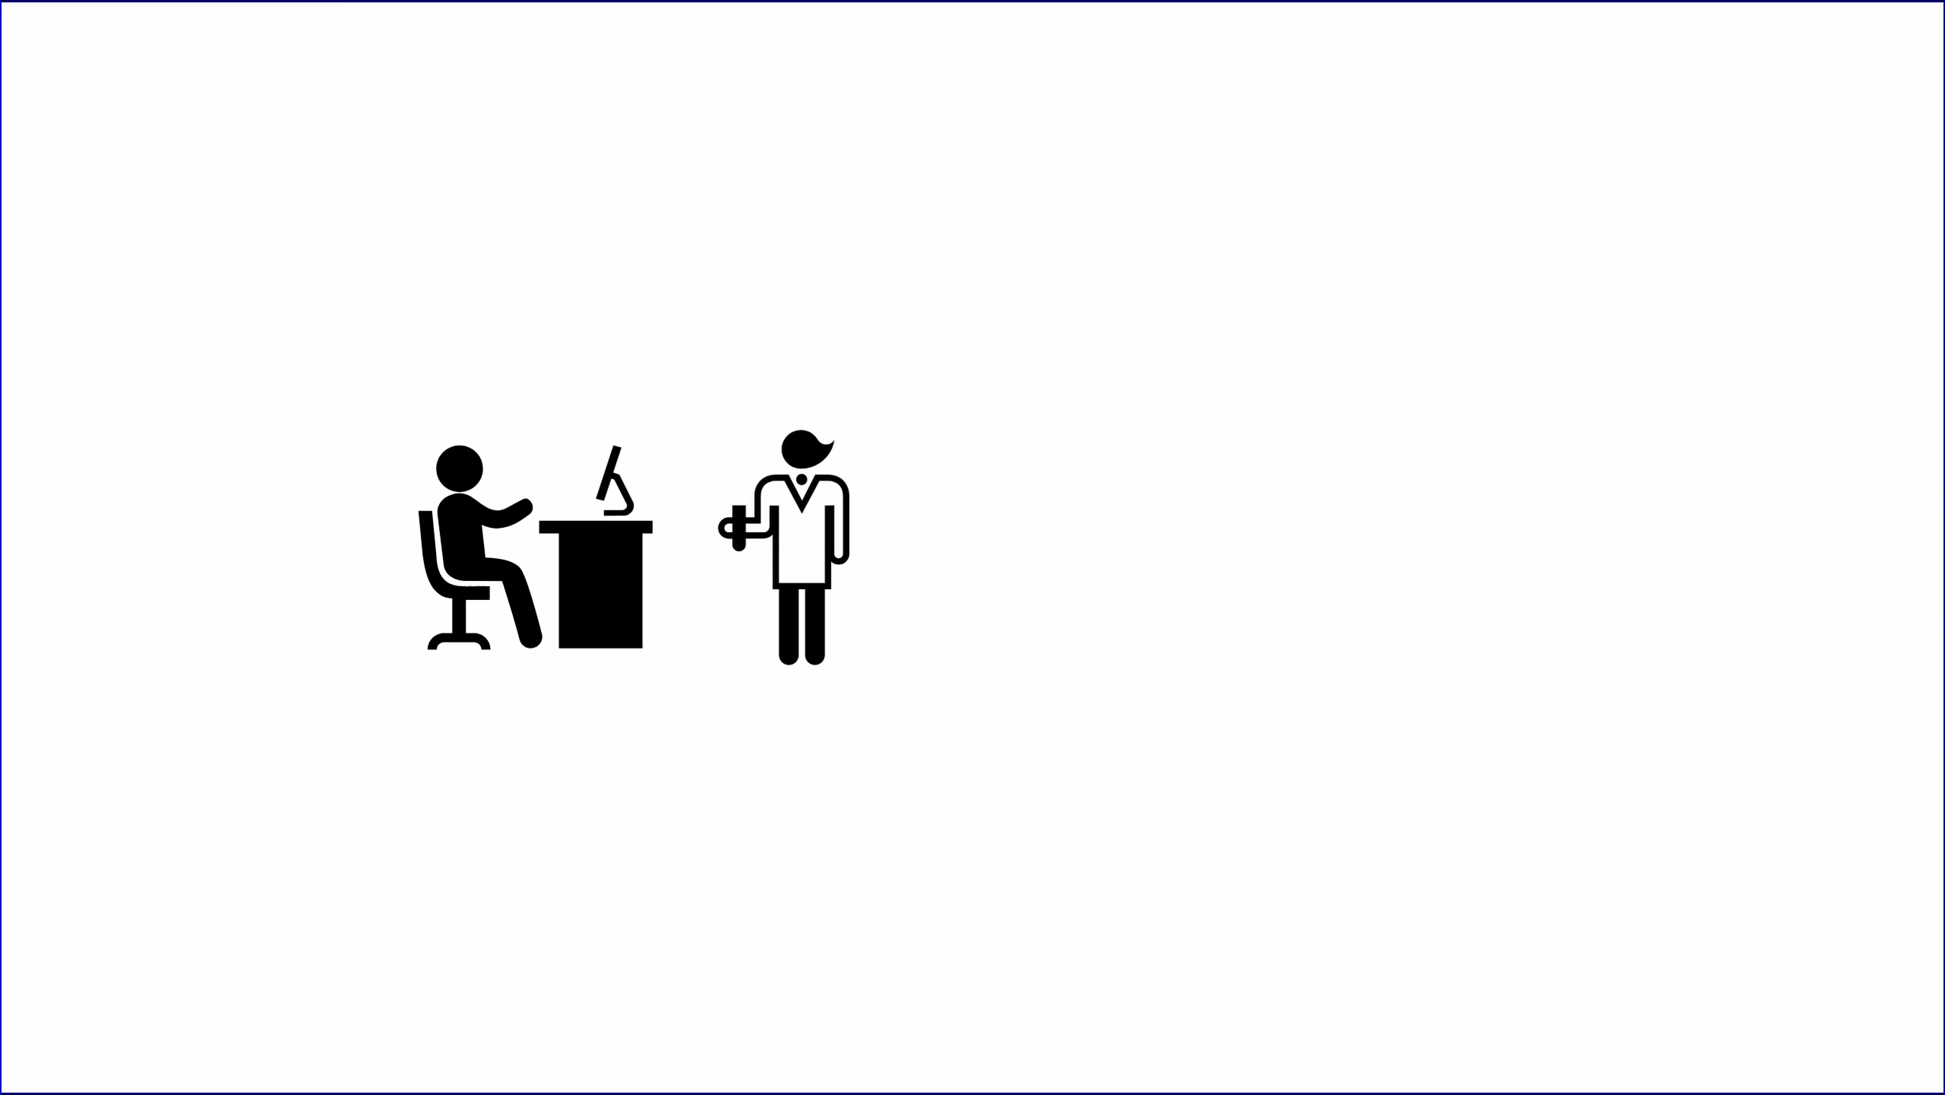
Notes:
Control

Slide 17
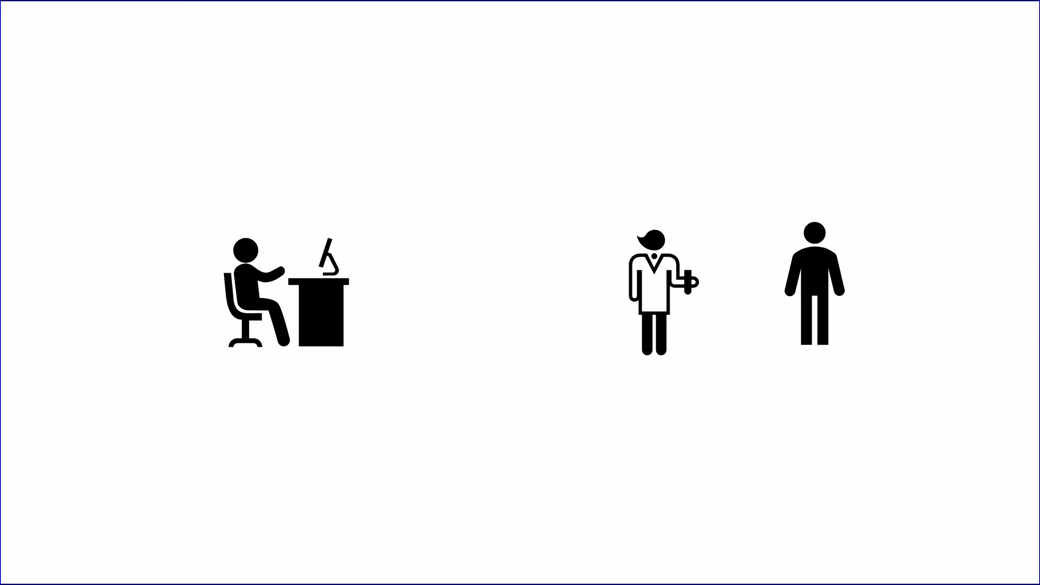

Slide 18
What's "Quality"?
¯\_(ツ)_/¯

Slide 19
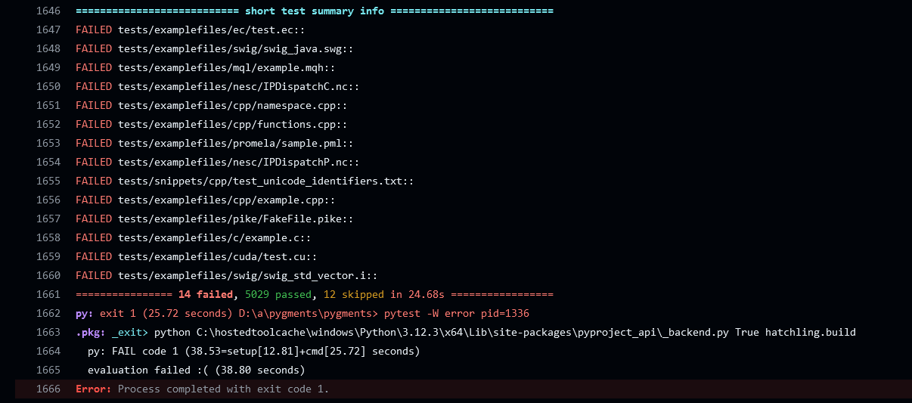
FAILED tests/examplefiles/ec/test.ec::
FAILED tests/examplefiles/swig/swig_java.swg::
FAILED tests/examplefiles/mql/example.mqh::
FAILED tests/examplefiles/nesc/IPDispatchC.nc::
FAILED tests/examplefiles/cpp/namespace.cpp::
FAILED tests/examplefiles/cpp/functions.cpp::
FAILED tests/examplefiles/promela/sample.pml::
FAILED tests/examplefiles/nesc/IPDispatchP.nc::
FAILED tests/snippets/cpp/test_unicode_identifiers.txt::
FAILED tests/examplefiles/cpp/example.cpp::
FAILED tests/examplefiles/pike/FakeFile.pike::
FAILED tests/examplefiles/c/example.c::
FAILED tests/examplefiles/cuda/test.cu::
FAILED tests/examplefiles/swig/swig_std_vector.i::
================ 14 failed, 5029 passed, 12 skipped in 24.68s =================
py: exit 1 (25.72 seconds) D:\a\pygments\pygments> pytest -W error pid=1336
Notes:
https://github.com/pygments/pygments/actions/runs/9151732395/job/25421858065

Slide 20


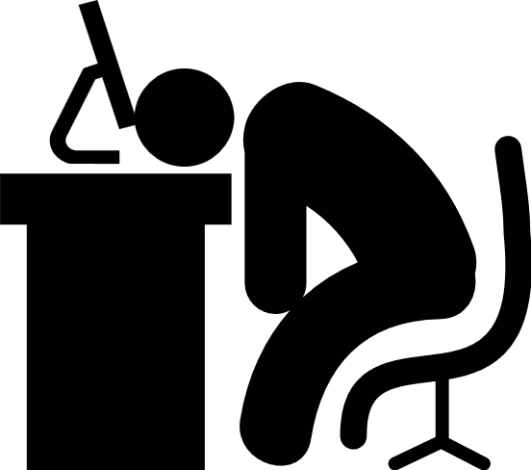
30 years
3 months

Slide 21

prove □∀n◇∃r φ(n, r)
yeah ok
center a div
what usay?

Slide 22
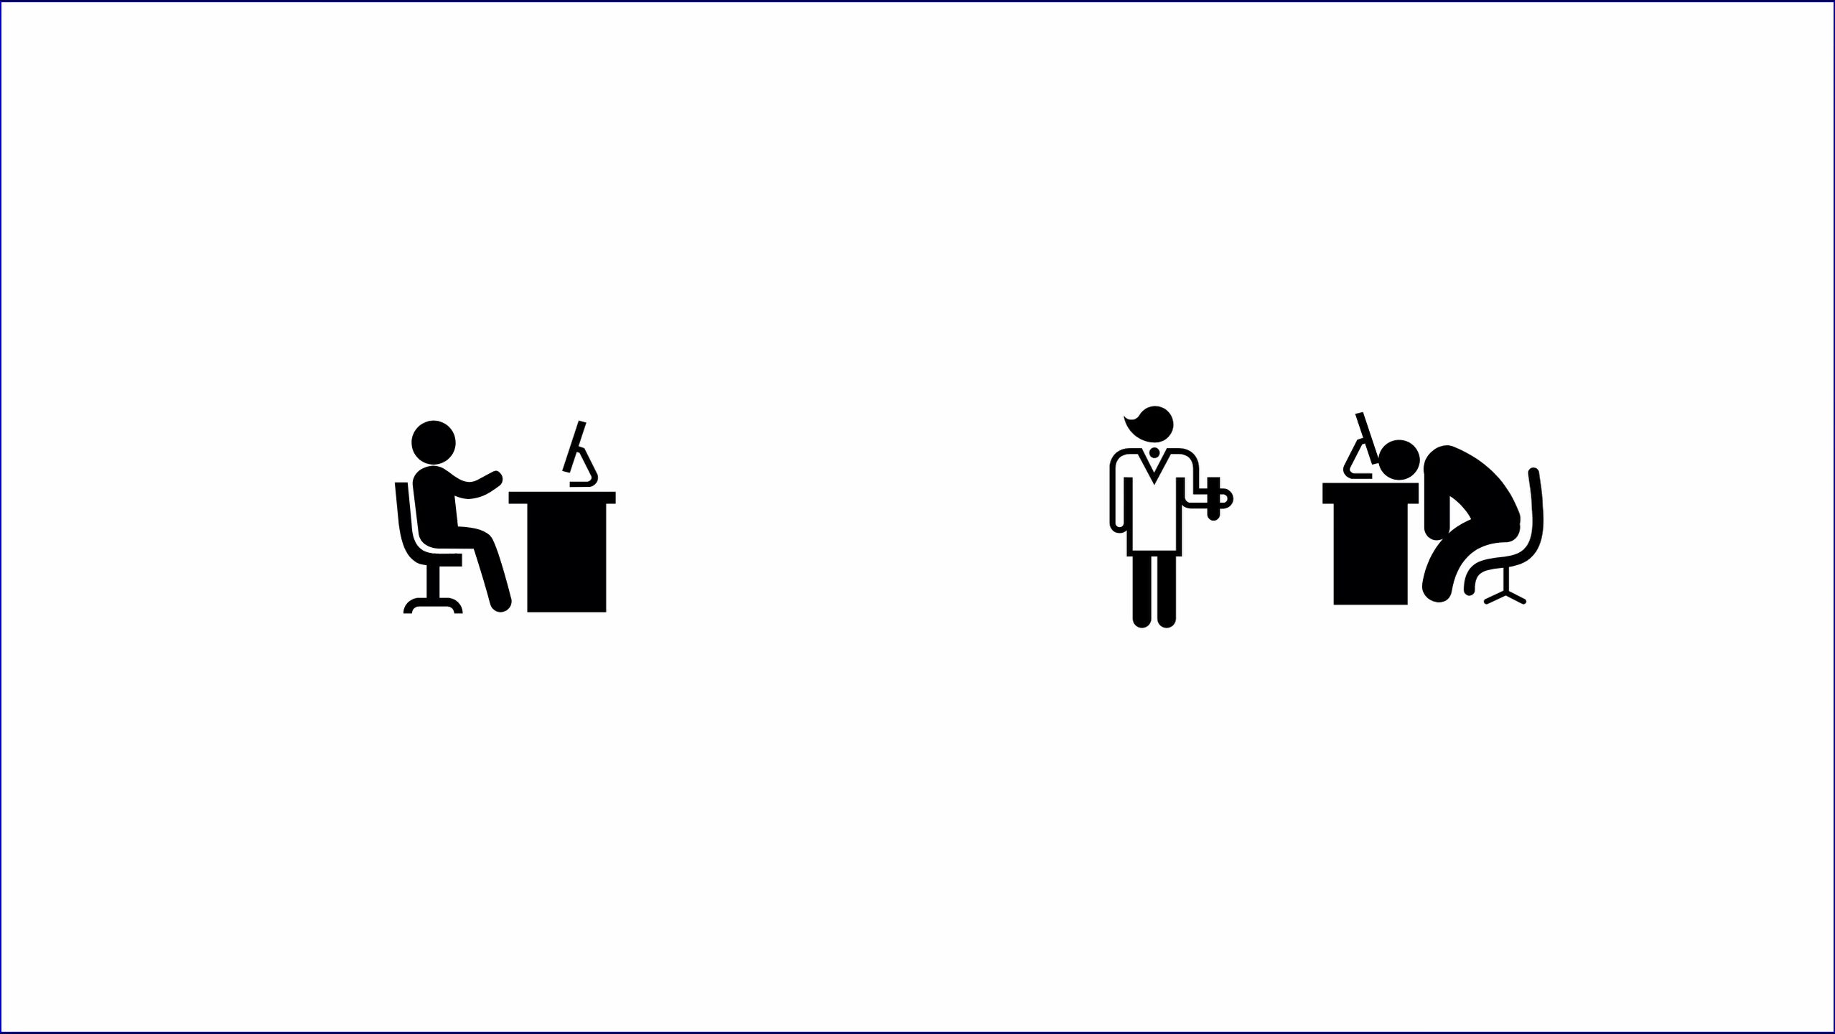

Slide 23
€€€
Notes:
Millions of euros to run

Slide 24
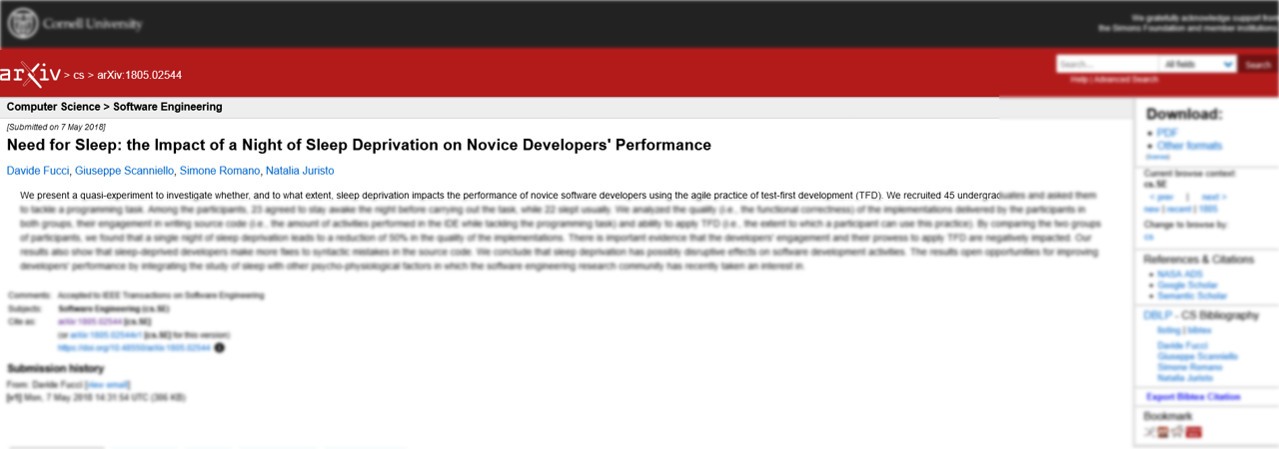
50%
Notes:
6 of 13

Slide 25
Takeaways
Give a starting file in code review
Take more naps

Slide 26

+5%

Slide 27
Clinical trials are hard.
Notes:
Most people's exposure

Slide 28



nah
Notes:
“Animate on ‘is give up’”

Slide 29
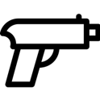
Notes:
Can't force a person to smoke in a lab

Slide 30
Natural Experiment
Notes:
“Usually getting all the data is hard”

Slide 31
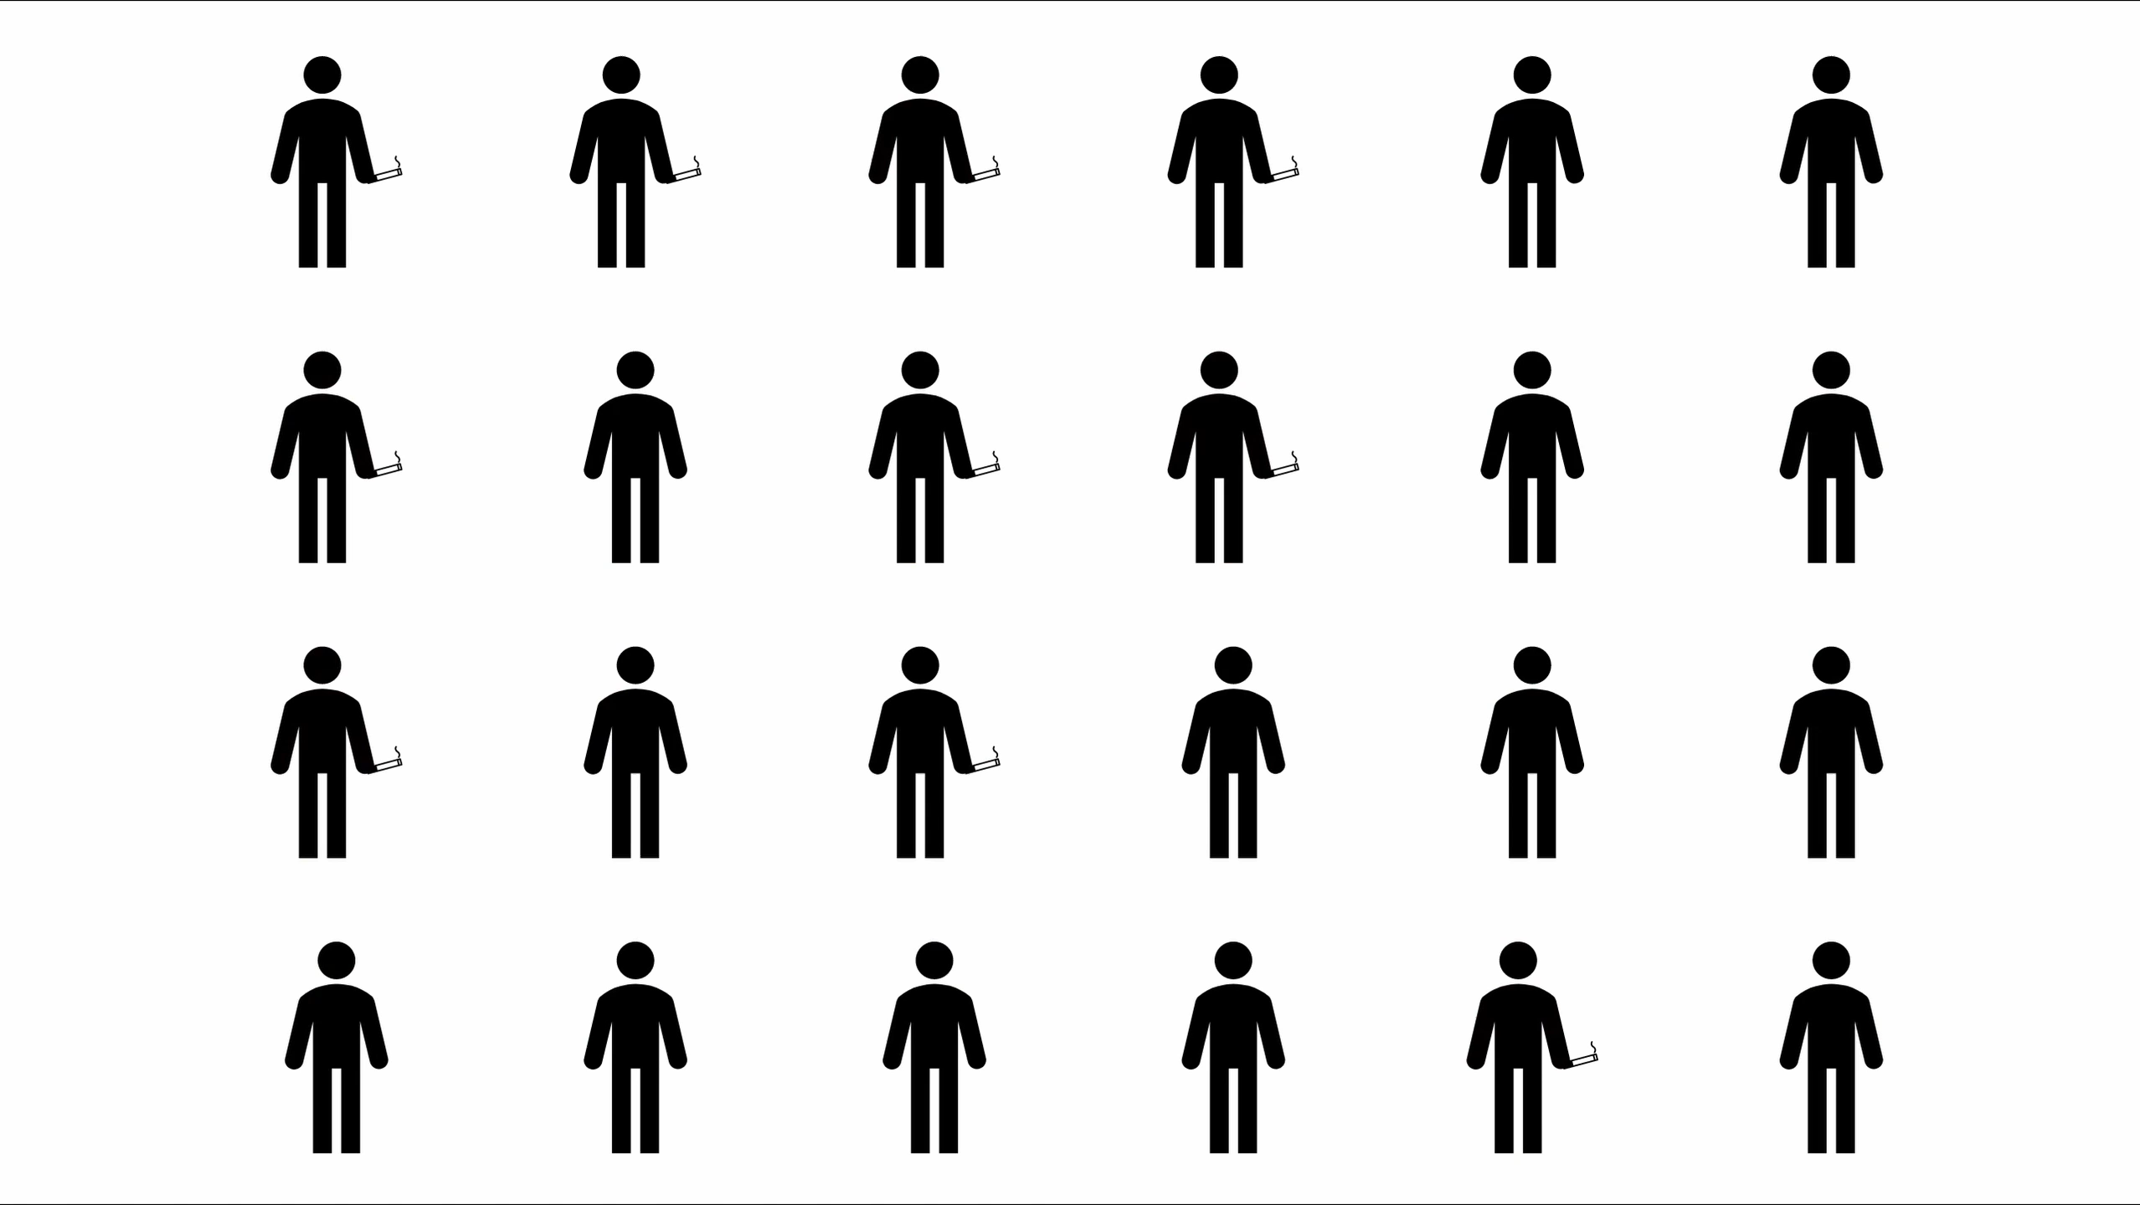

Slide 32
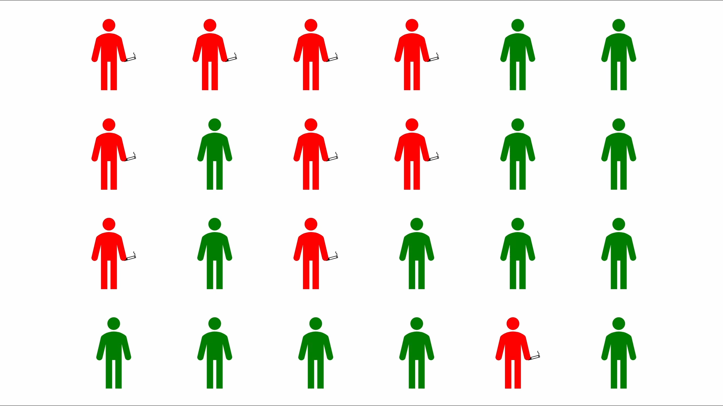
Notes:
Say correlation

Slide 33
Scientific Method
Observe
Predict
Test
Evaluate
Observe More
Notes:
You can think of it like replacing the "Test" with "Observe More"
Question is how we get the data

Slide 34
Surveys
Notes:
Means of gathering data from natural experiments

Slide 35
72.6% of participants [in the study] rejected the idea that files’ position influenced their ability to find [a bug].
- Impact of File Position of Code Review
Notes:
77 of [106]
The hidden psychological factors of code review. At the end of
our experiment, we showed the participants the defects we seeded
in the code. When asked whether the position of the bugs might
have had an impact on their ability to detect them, a vast amount of
the developers replied negatively. A total of 77 (72.6%) participants
rejected the idea that files’ position influenced their ability to find
for the Corner Case defect. However, the results of our experiment
found evidence of the contrary. The impact of file position on reviewers
was also corroborated by the first part

Slide 36
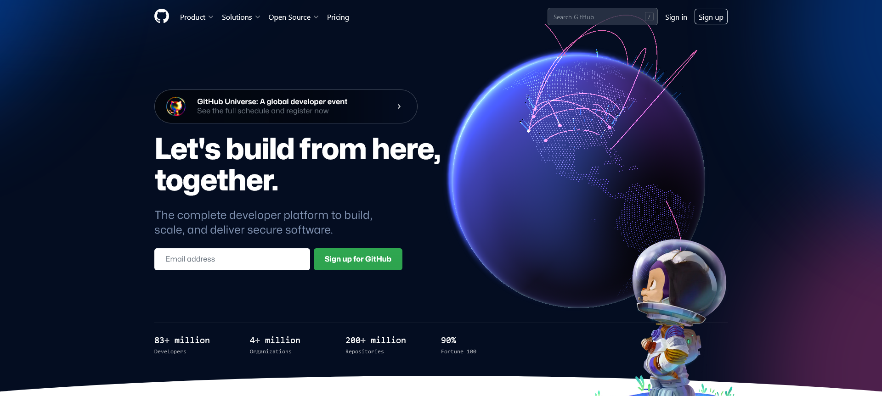
Notes:
We have a better repository of natural data

Slide 37
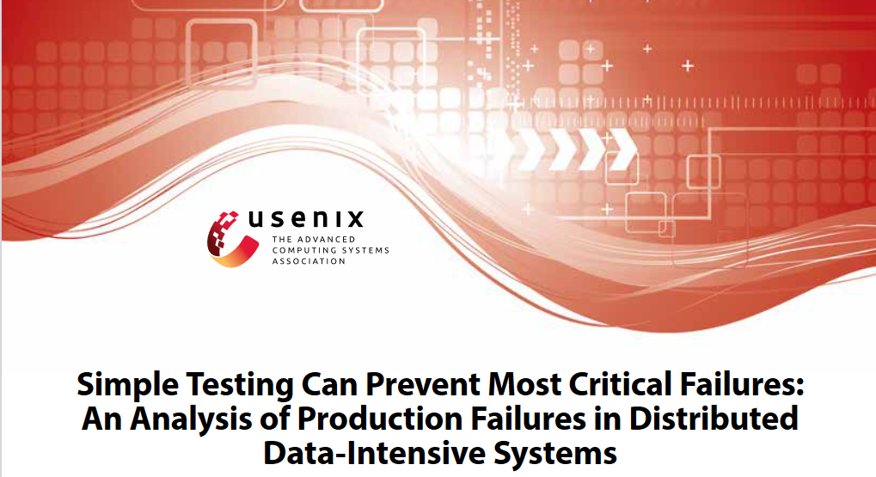
Notes:
https://www.usenix.org/system/files/conference/osdi14/osdi14-paper-yuan.pdf
https://www.eecg.utoronto.ca/failureAnalysis/

Slide 38
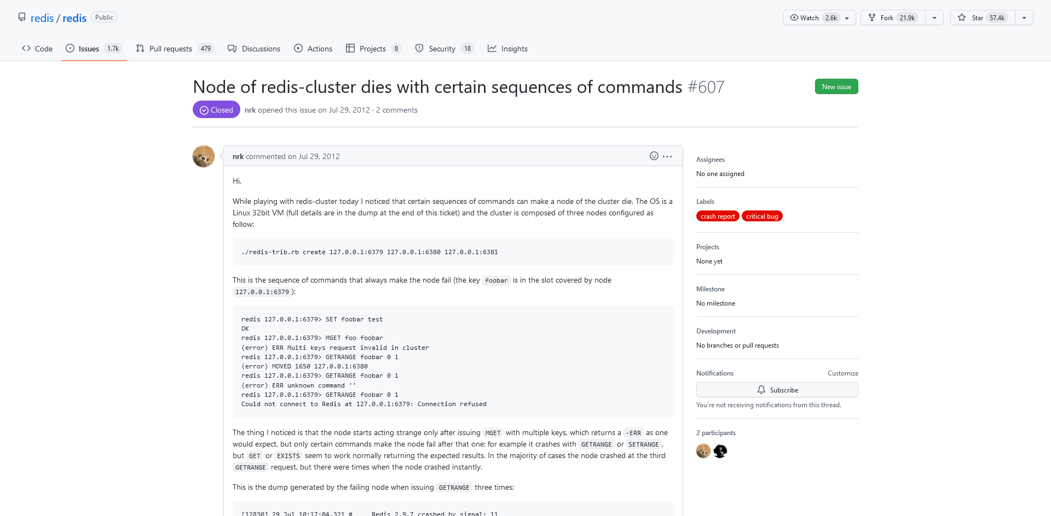
Notes:
https://github.com/redis/redis/issues/607

Slide 39
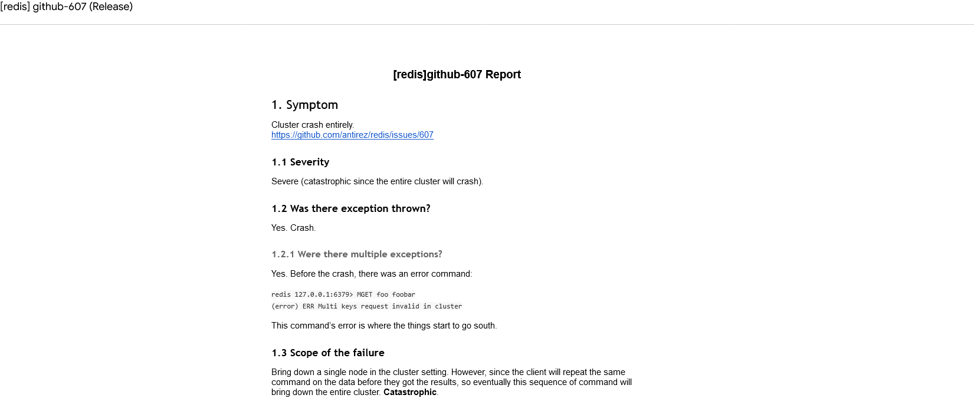
Notes:
https://docs.google.com/document/d/1q0wQkD53J_BHbauPVGtg3pxLdp_1747gQI2Llcxql8s/pub

Slide 40
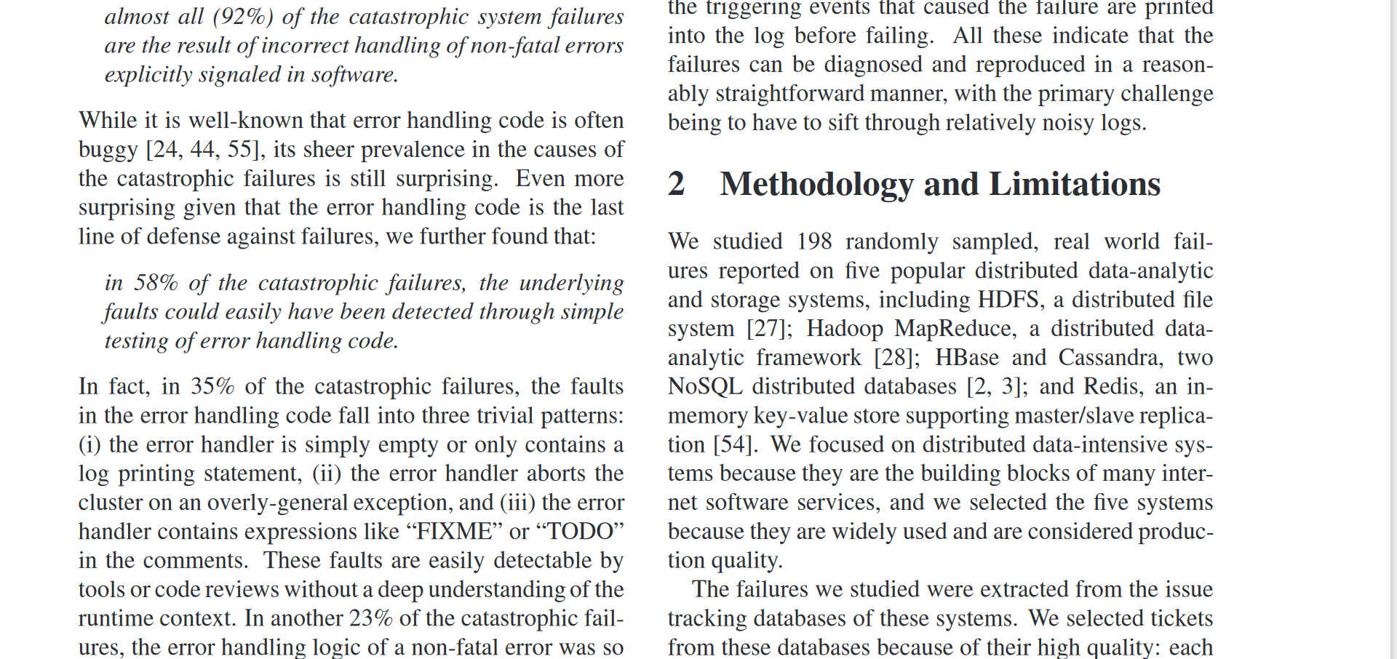

Slide 41
Takeaways
Give a starting file in code review
Take more naps
Write your unit tests

Slide 42
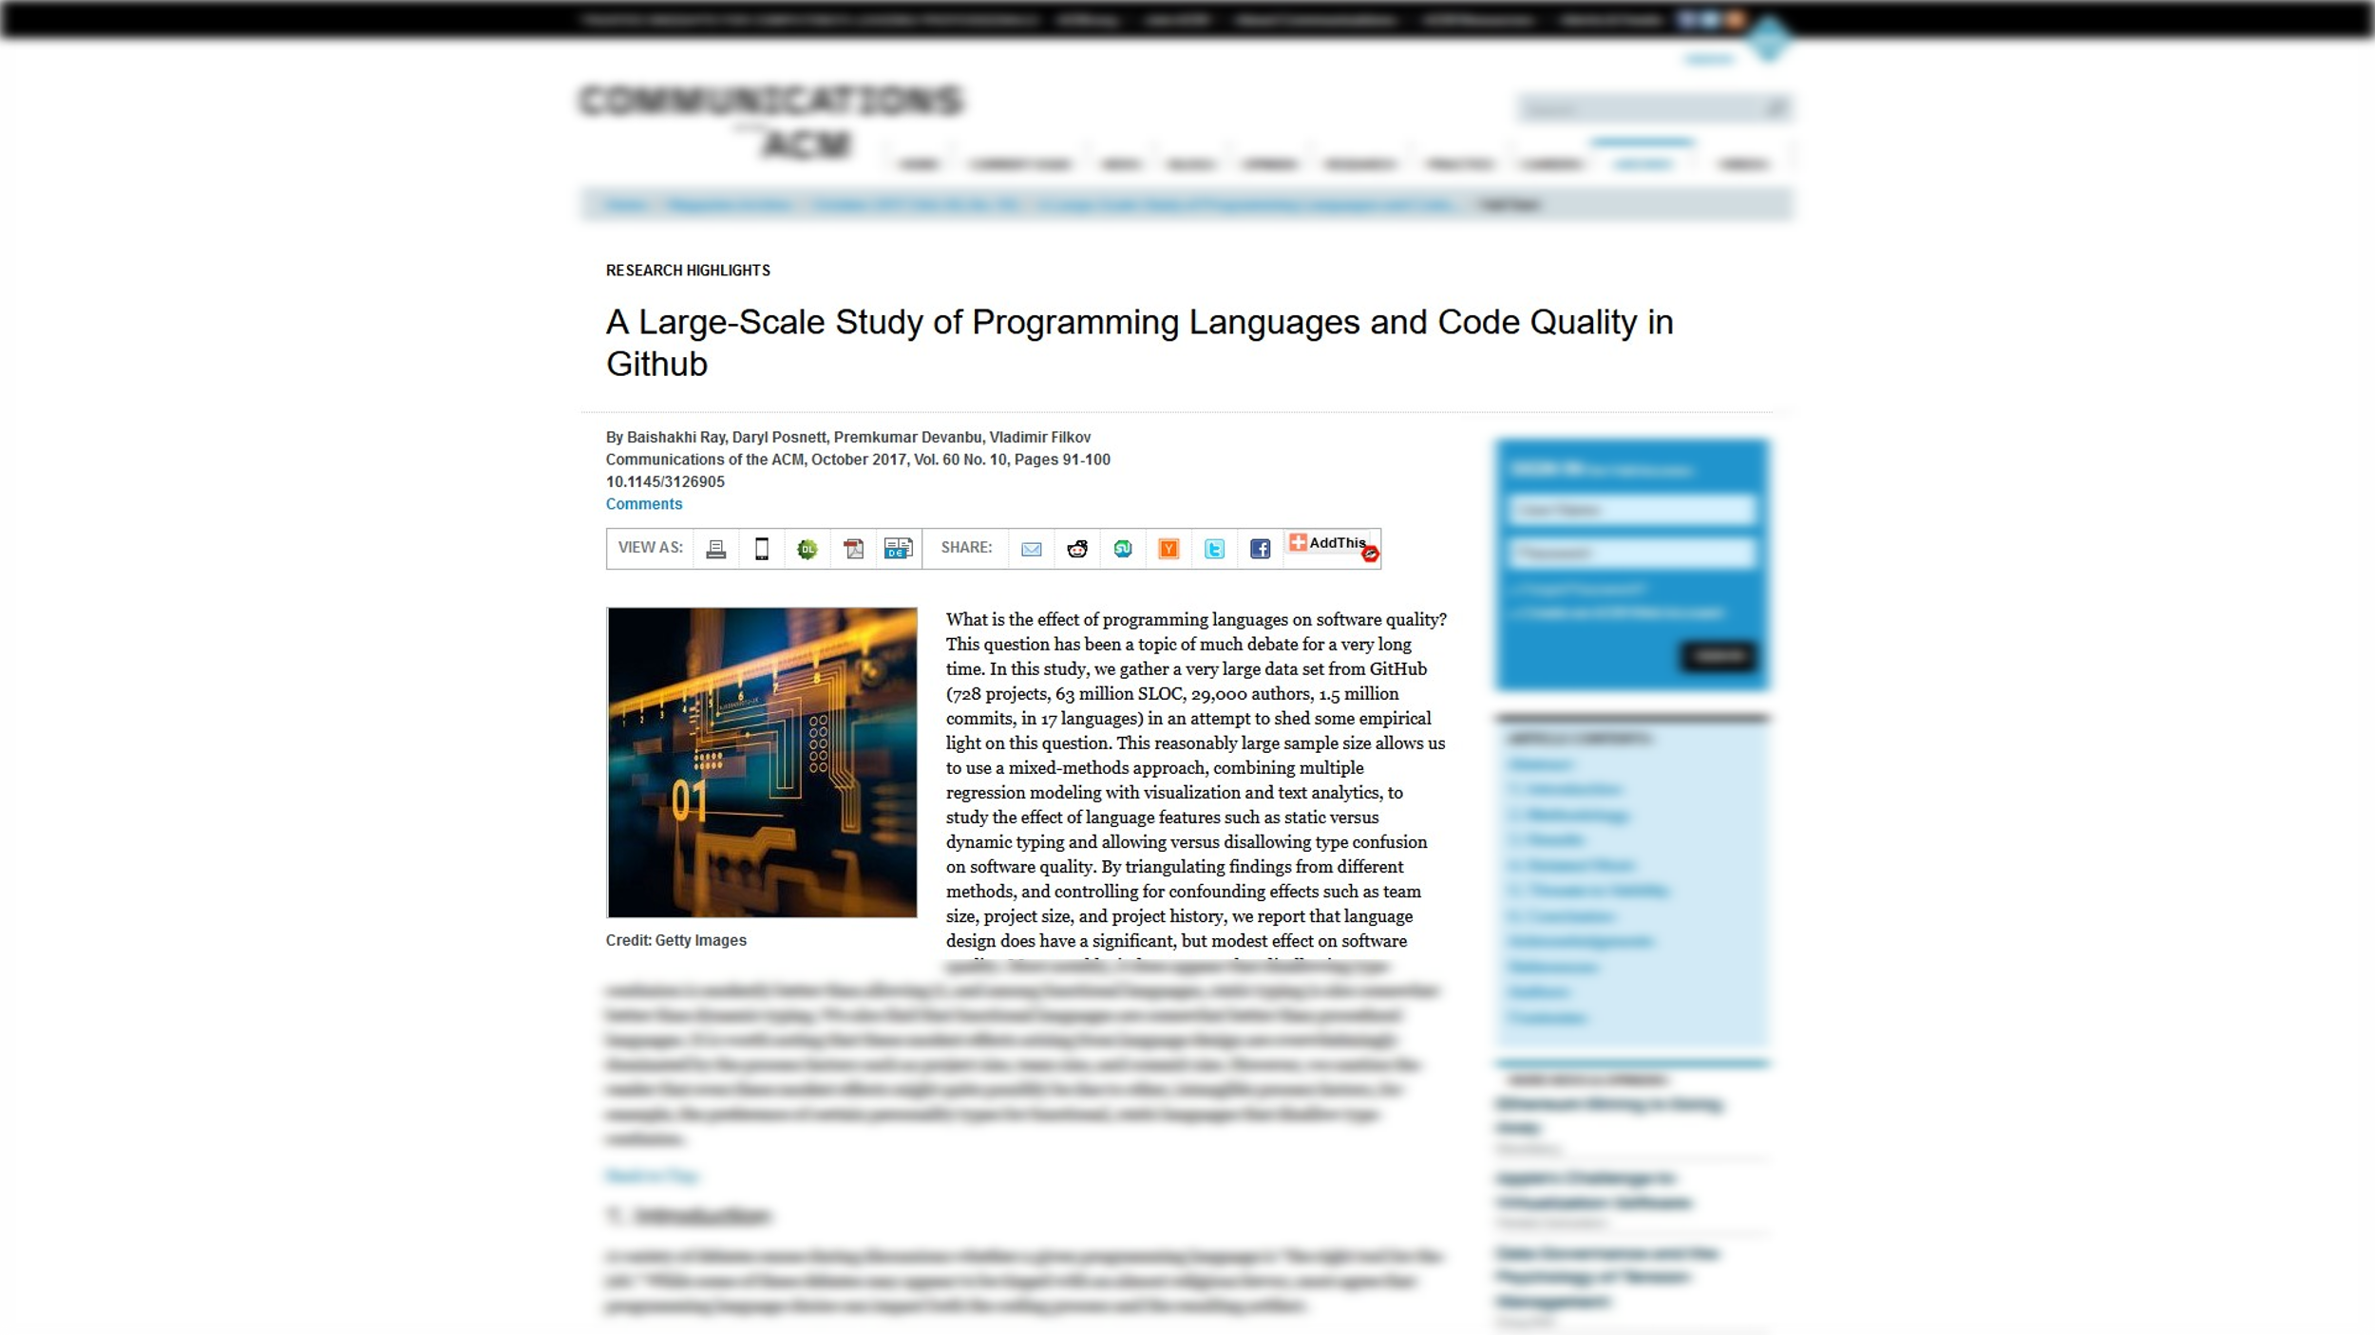

Slide 43
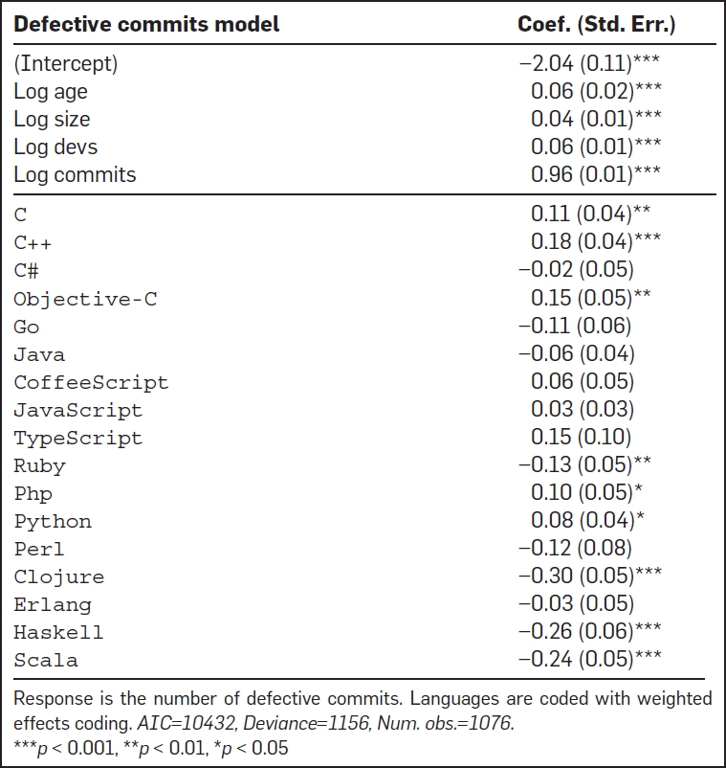
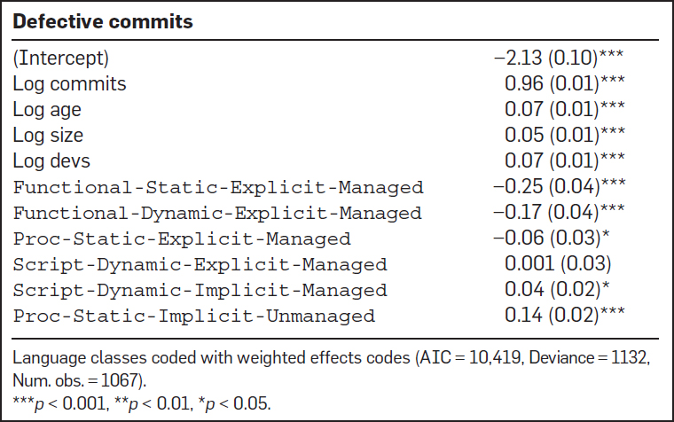

Slide 44
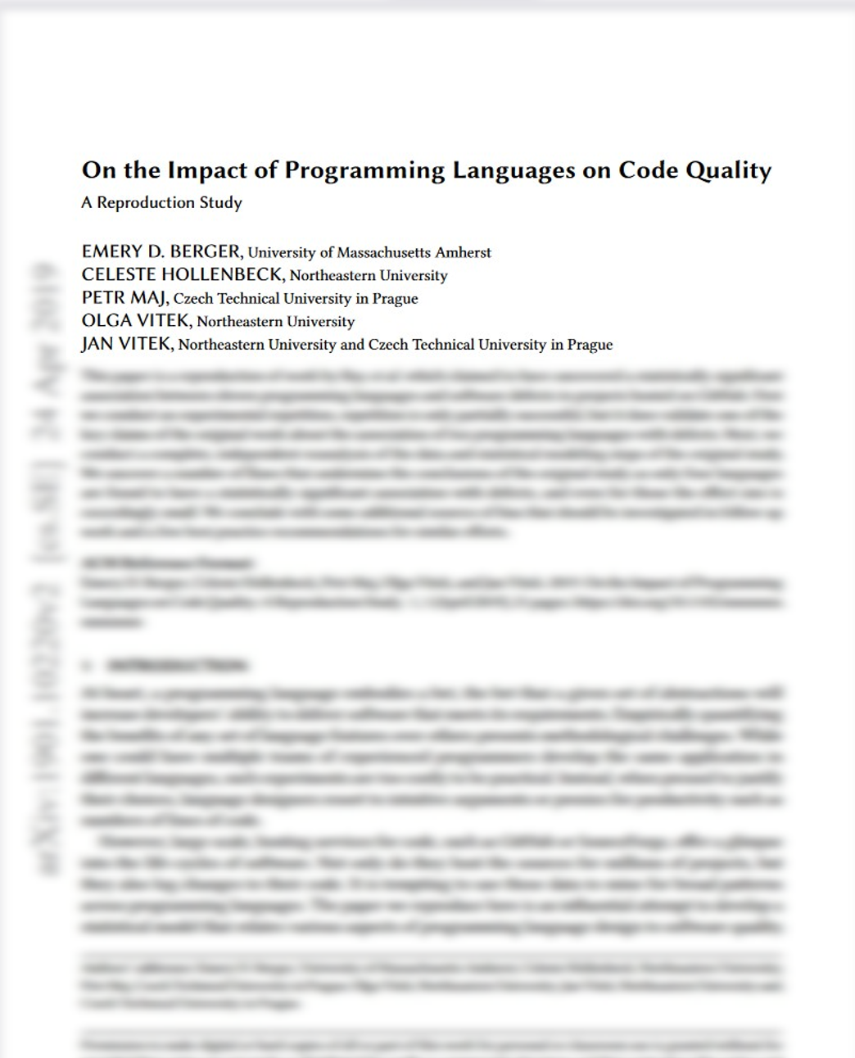

Slide 45
“Fix typos in docs”
“Add bug reporting instructions”
“Allow fixc [function] to take rands”
“Add lazyness to infix operators”

Slide 46
Problems with Natural Experiments
Messy data
Shows outcome, not process

Slide 47
Qualitative Research

Slide 48



Interviews
Notes:
Interviews

Slide 49

Observation
Notes:
Observation

Slide 50
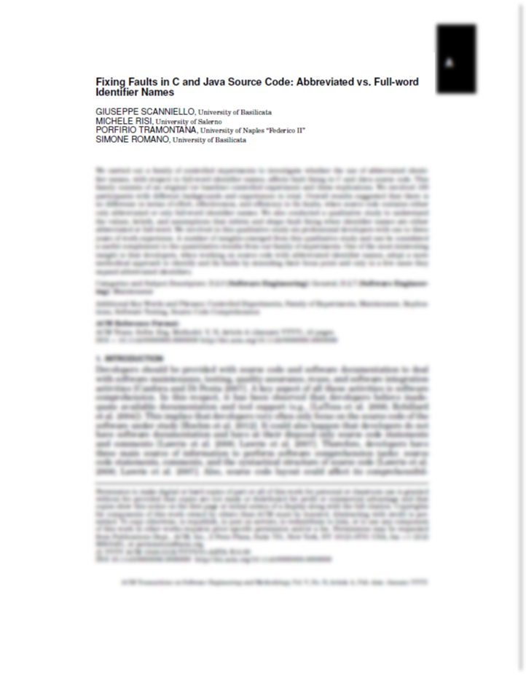

Slide 51

employee_reservation_id
emp_rid
Notes:
Second, there could be several ways to abbreviate an identifier and the likelihood to
choose the wrong textual query is high and could affect search results.
Developers that fixed faults in source code with abbreviated identifiers (with respect
to those provided with source code having full-word identifiers) investigated enough of
the JGraphT code to understand its high-level structures. It seemed that these devel-
opers prepared a detailed plan of the identification of faults and of the changes to be
made on the source code to fix these faults. In contrast, the behavior of developers dealt
with full-word identifiers seemed more opportunistic (antonym of methodical) because
they relied heavily on code skimming and guessing. The methodical approach did not
lead to a longer time to finish fault fixing task

Slide 52
Takeaways
Give a starting file in code review
Take more naps
Write your unit tests
Be mindful of how you read code

Slide 53
Recap
Science is hard
Lots of ways to do it:
  Clinical Trial
  Natural Experiments
  Qualitative Experiments
  Interviews
  Observation
  And more!

Slide 54

ADVERT
Hire me!
I teach workshops
www.hillelwayne.com/consulting
"White House recommended"
Past clients: NASA, Netflix, Facebook, Siemens

Slide 55
Intentionally Blank
Notes:
Nothing

Slide 56
Notes:
4*50=200*5=1000

Slide 57
So how do we learn?

Slide 58
Let's look at DDD!
(Thanks to Chris Simon!)
Notes:
Nothing

Slide 59
See website for papers!
www.hillelwayne.com/talks/ese/ddd
Notes:
Code review papers

Slide 60
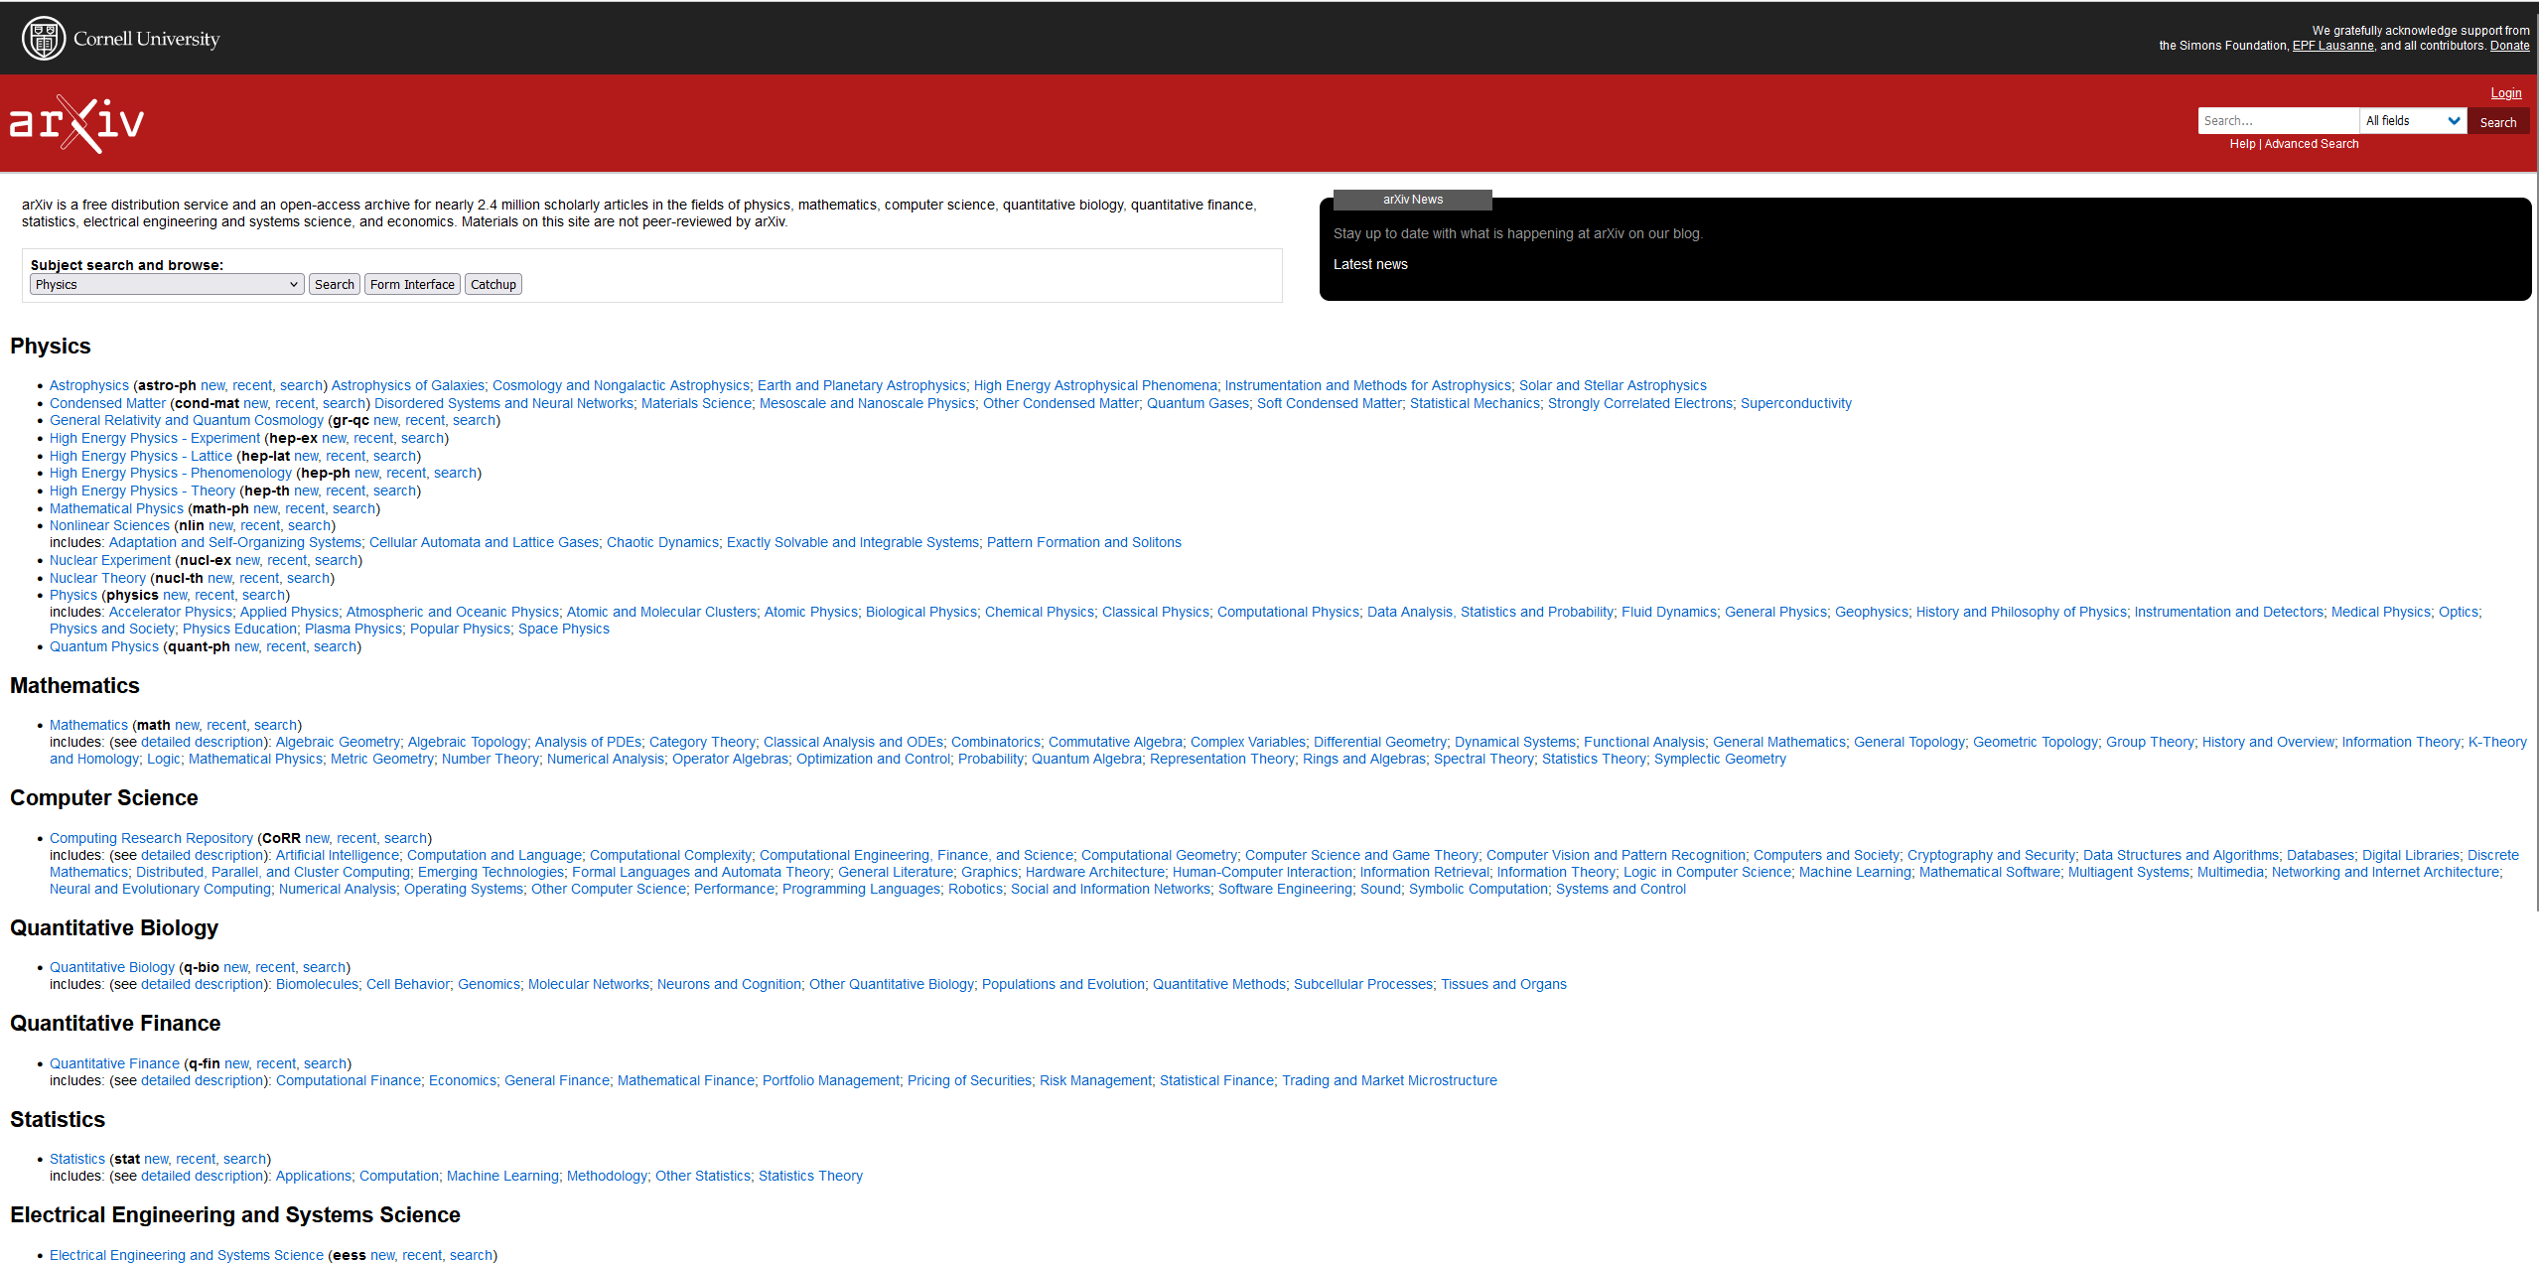
Websites

Slide 61
Survey Paper

Slide 62
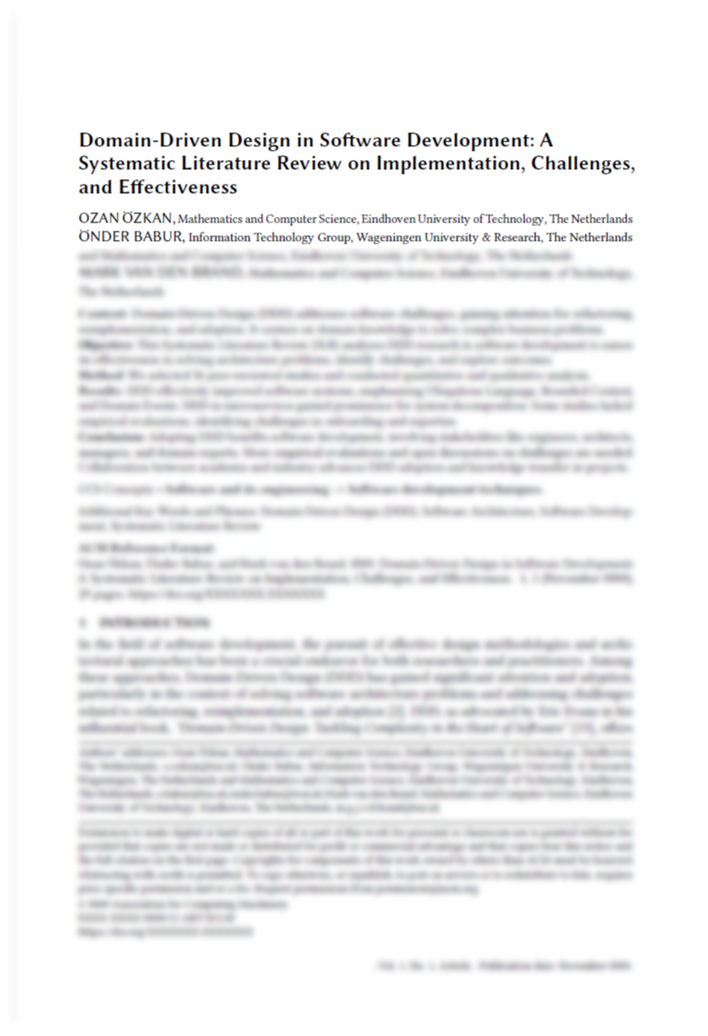
Notes:
Survey paper: looks
36 papers

Slide 63
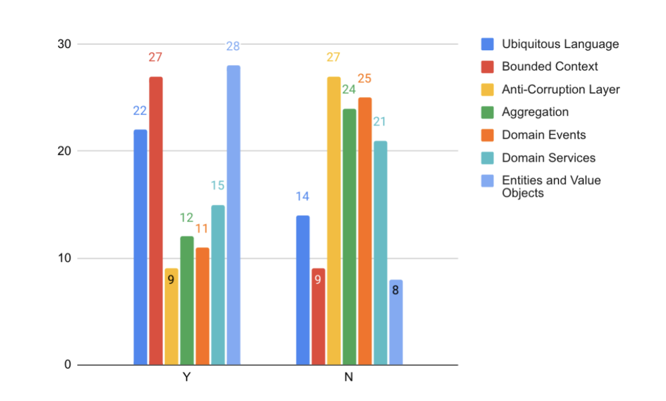

Slide 64
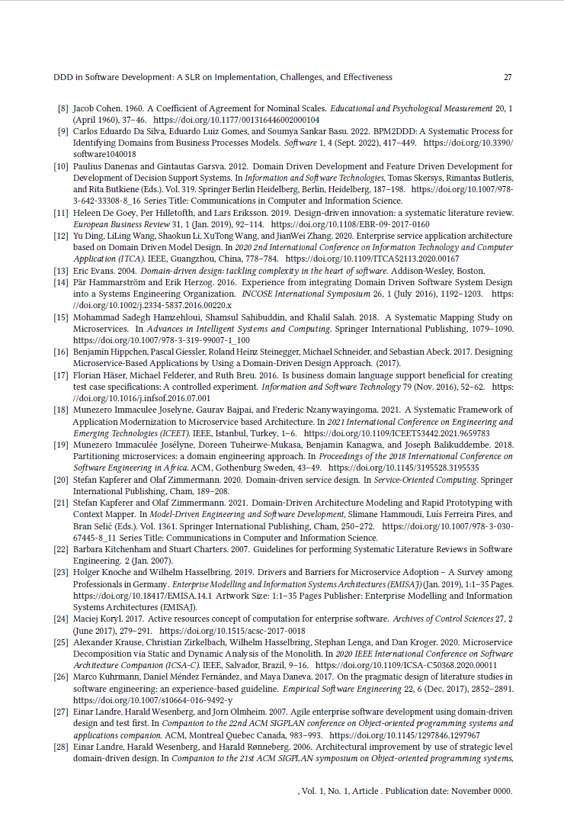

Slide 65

Build the Web

Slide 66
READ EVERYTHING.

Slide 67
Some interesting DDD papers

Slide 68
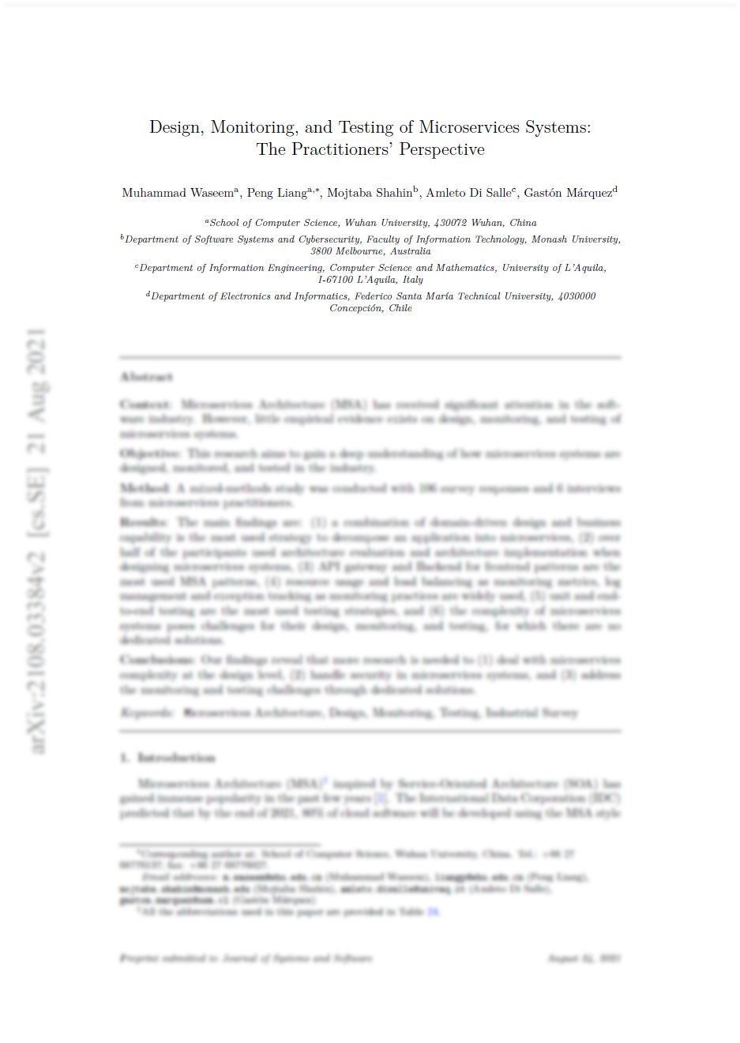
DDD for microservices

Slide 69
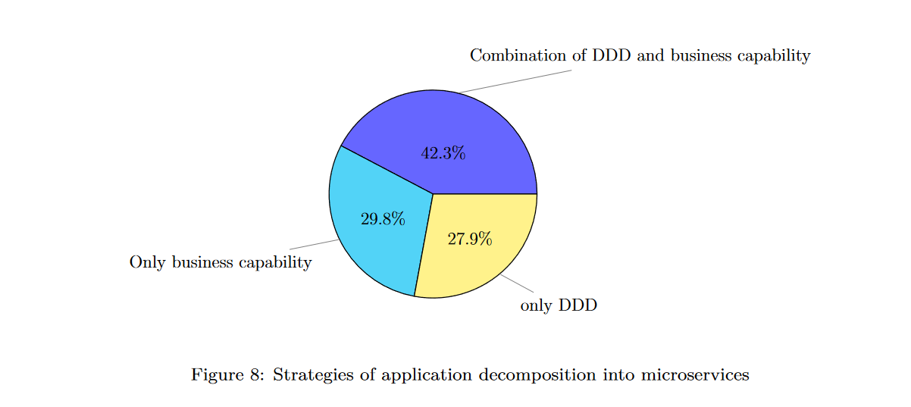
Notes:
Developers struggle most with systems that have to span multiple bounded contexts.
Some reasons people claim not to use DDD: too complicated, does not necessarily lead to scalable or performant architectures, difficult to combine with “business capabilities” (where microservices are broken down by org chart), not enough microservices to justify it.

Slide 70
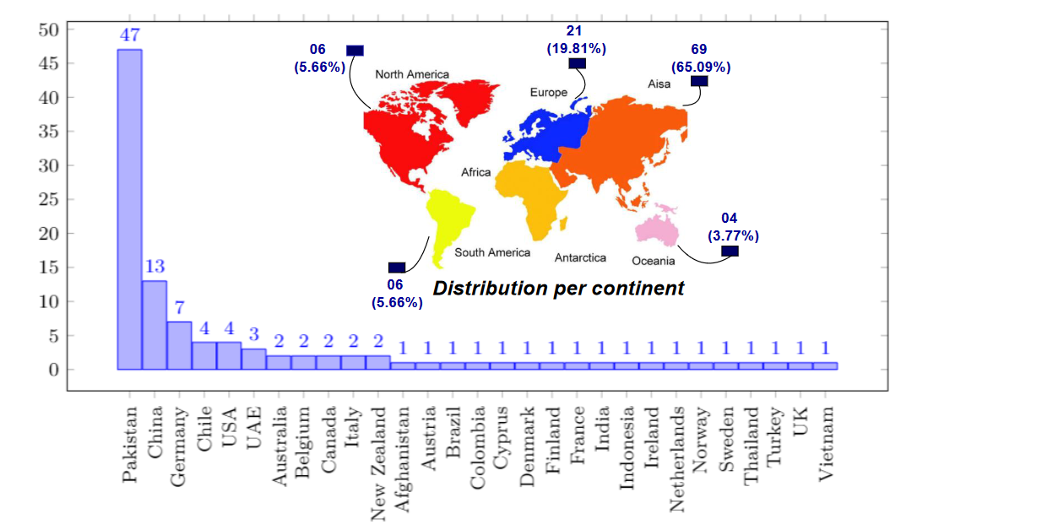

Slide 71
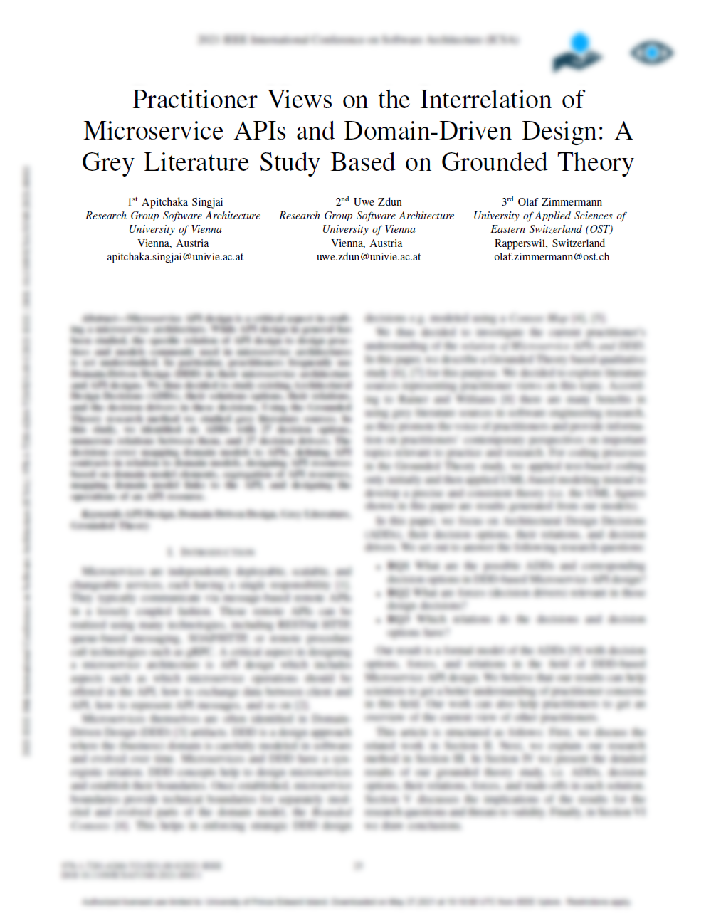
Notes:
APIs of DDD’d systems tend to be treated as collections of bounded context APIs, as opposed to exposing the whole domain model as an API.

Slide 72
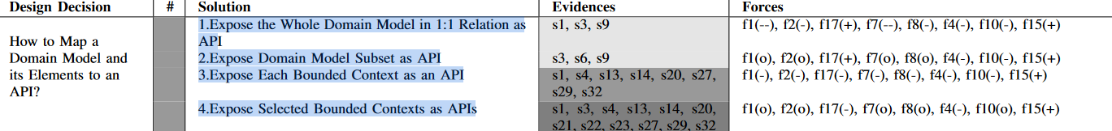

Slide 73
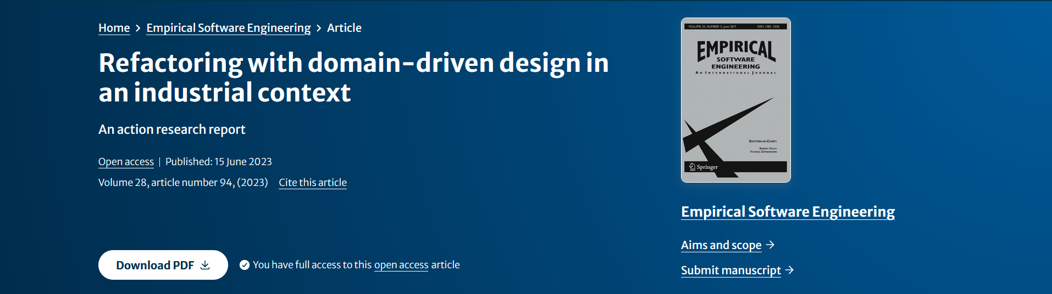
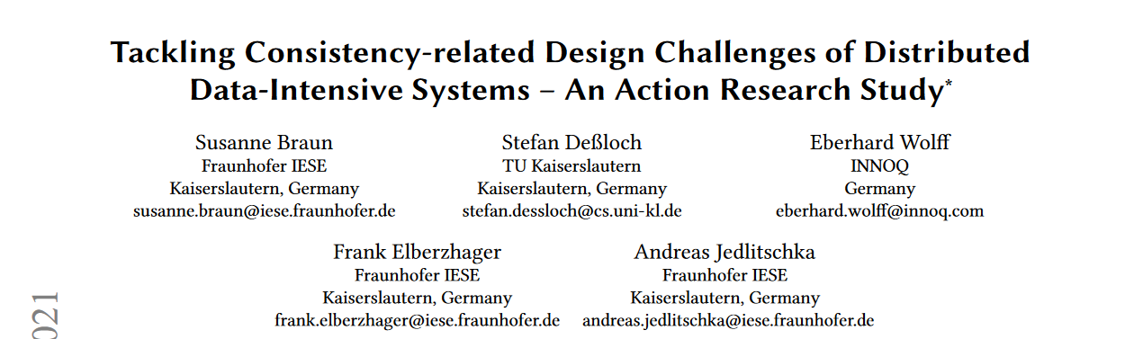

Slide 74
www.hillelwayne.com/talks/ese/ddd

Slide 75
Conclusions
Science is hard
We’re not very good at it
Don't believe me: decide for yourself!
Notes:
Science is hard

Slide 76
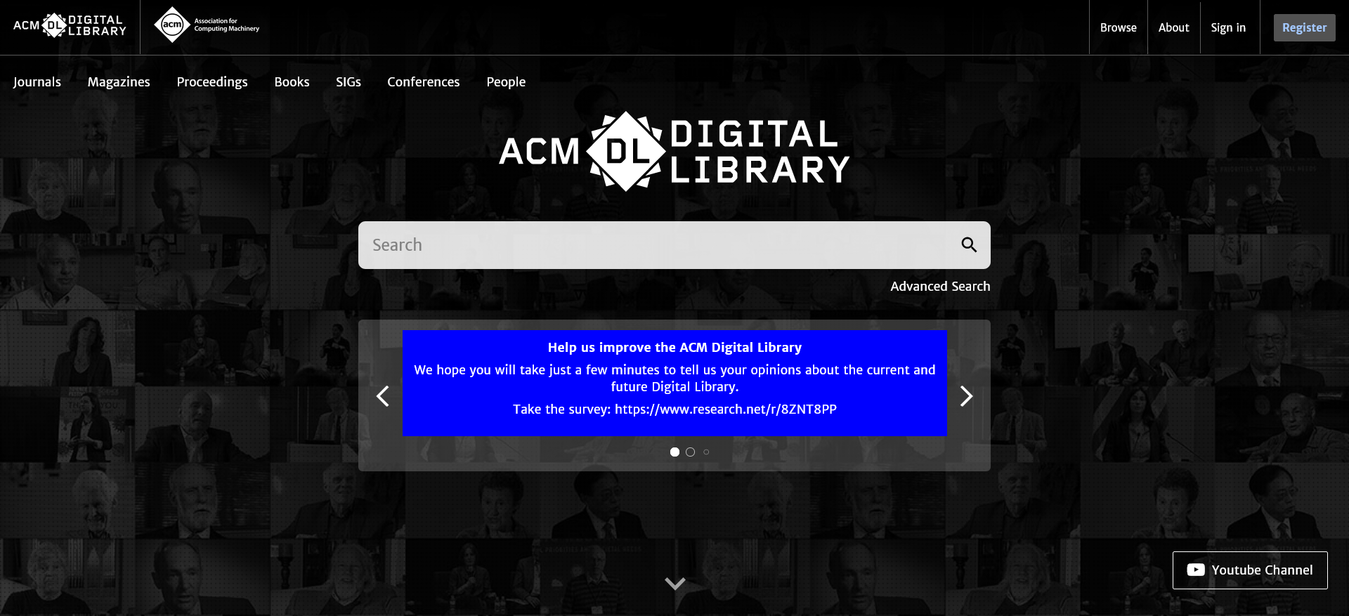

Slide 77
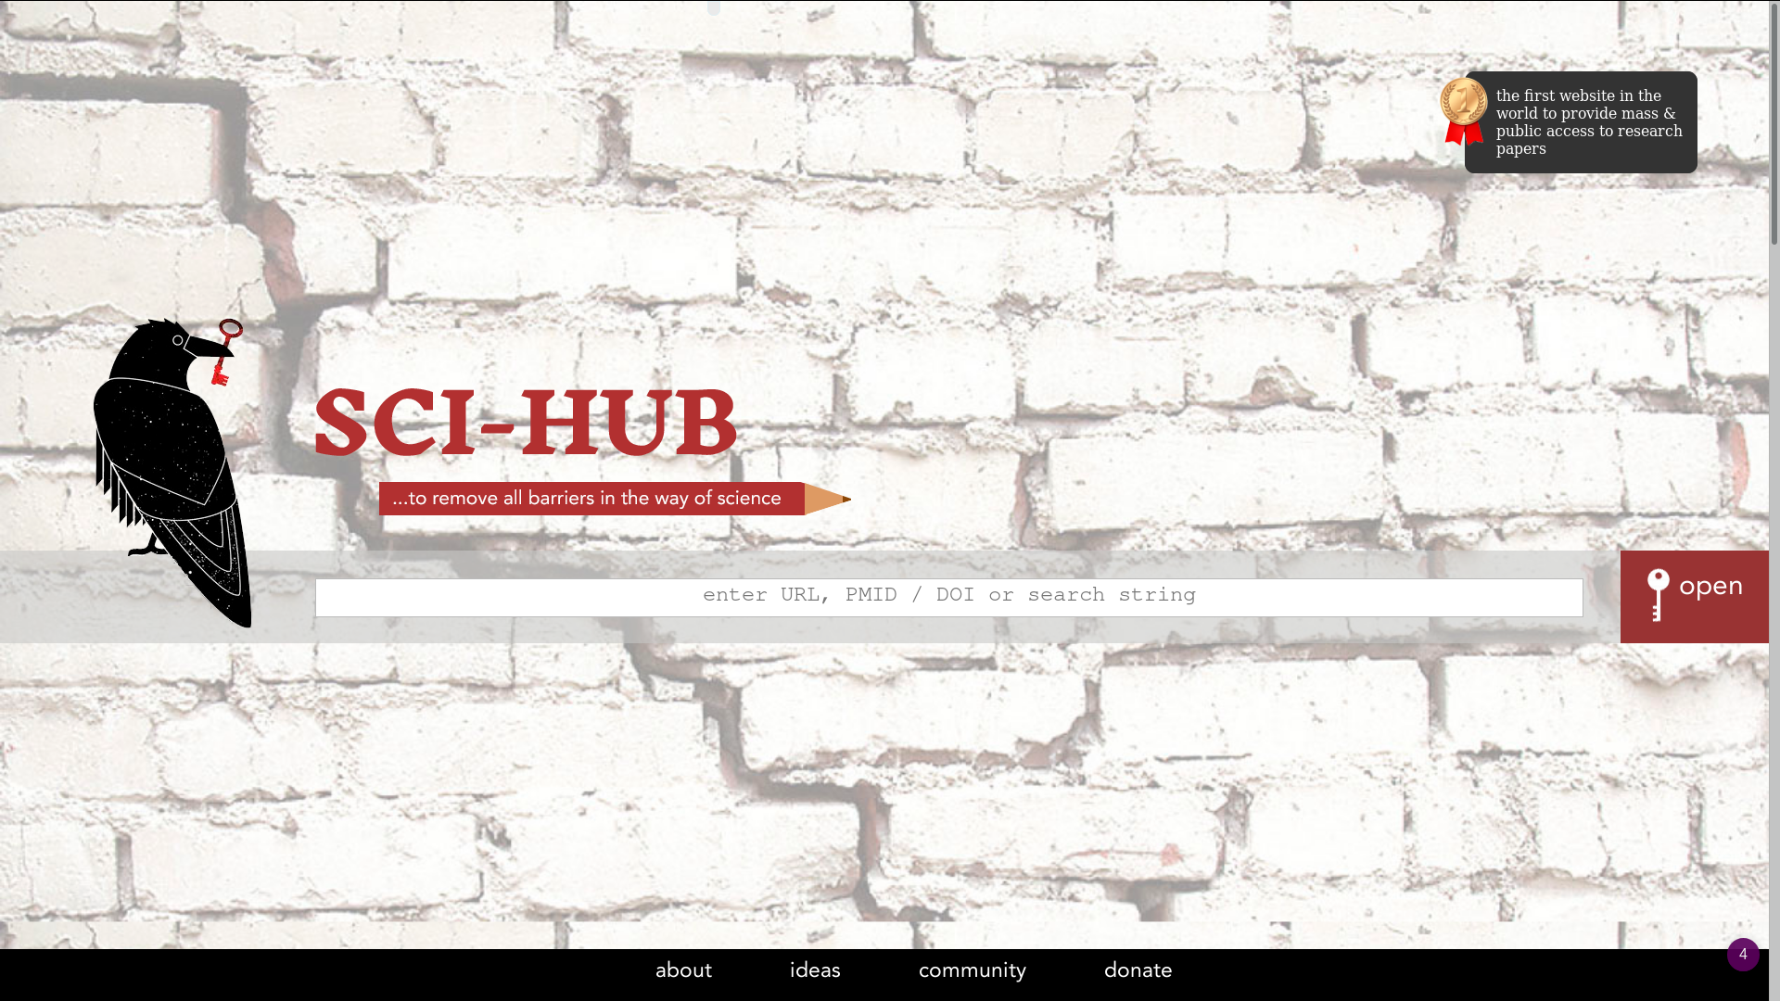

Slide 78
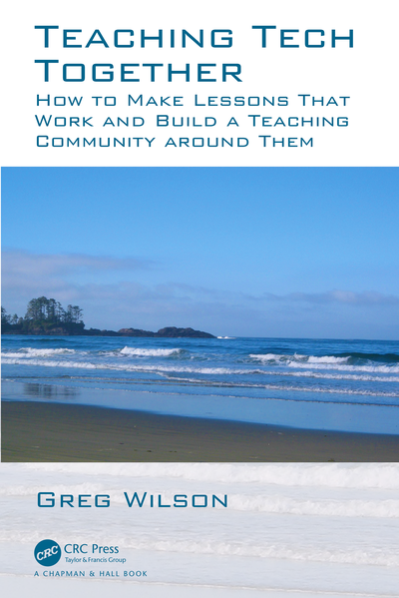
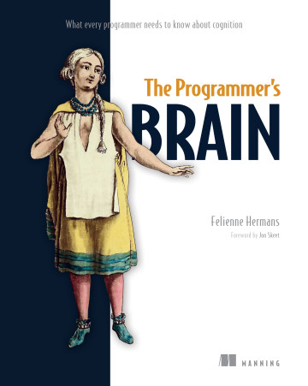
Notes:
Vrije Universiteit Amsterdam

Slide 79
Takeaways
Give a starting file in code review
Take more naps
Write your unit tests
Be mindful of how you read code
Hire me to teach a formal methods workshop

Slide 80
Thank you!
(and thanks Chris!)
Notes:
Chris Simon

